Slide 1

Title
Stephen McLaughlin
PhD Student

Slide 2
Stephen McLaughlin / @SteveMcLaugh
Notes:
This is not an option.

Slide 3
Commercial speech-to-text services
IBM Watson: 1000 mins/mo. free, then $0.02/min (USD)
Google Cloud Speech API: $0.024/min (USD)
Bing Speech API: $0.09–0.15/min (USD)
Pop Up Archive: $0.20–0.25/min (USD)
Facebook’s Wit.ai: Free, mystery rate limit. Data stored & made public.
Stephen McLaughlin / @SteveMcLaugh

Slide 4
PocketSphinx
Fast, easy, decent output
Vocabulary: 134,723 words
C, Apache License 2.0
Python wrapper: speech_recognition (github.com/Uberi/speech_recognition)
Slow, difficult, very decent output
Pop Up Archive vocabulary: 145,123 words
C++, Apache License 2.0
Stephen McLaughlin / @SteveMcLaugh
Notes:
“PocketSphinx is a lightweight speech recognition engine, specifically tuned for handheld and mobile devices”
SphinxBase
“Sphinx4 is a pure Java speech recognition library.”

Slide 5
Title
1
2
3
4
Stephen McLaughlin / @SteveMcLaugh

Slide 6

David Antin, UPenn seminar, March 16, 2004 PocketSphinx Kaldi + PUA model
stores over the floodwaters was over guns constitutes a leopold because it is really a coleman the same way that go goals famous work good souls was titled by google in russian flamboyantly on the title page that's also a pall of russia in that sense i may regard myself as a poet i do not regard myself the poet is a bullet in the sense that shall we regarded himself was a poet when he wrote the stove and home to the skylark i do not regard myself as being close to john keats as opposed i don't even regardless of who's been close that alexander popov support than either famously this miserable throb revolt and robert frost was my idea of a kind of poetry or was interested him however i did regard sock produces decided what that i'm a goner is as a possibility that socrates and the tinge line on most of the evidence would can gianni was a surprise to provence bought this organism that confronted the rug on
so was over before the waters was offered as constitutionally appalled because it's usually a poem in the same way that goggles famous work the dead souls was titled by gogol in russian flamboyantly on the title page that sells a poem of russia in that sense and they regard myself as a poet i do not regard myself a poet as a poet in the sense that shelly regarded himself as a poet when it wrote the severe come to the skylark i do not regard myself as being close to john keats as a poet i don't even regardless of as being close to alexander pope as a poet and i are famously dismissed rubble of robert lowell and robert frost as my idea of the kind of poetry i was interested in however i didn't go as socrates as so if what that is as a possibility that of socrates and that enshrine and those as i didn't say this change time he was a suppressed relevance as socrates and that changed on could be rude boy
Stephen McLaughlin / @SteveMcLaugh
Notes:
advertise Getty DL set

Slide 7
Antin-David_Studio111-Q_A_UPenn_3-16-04_1min
{ "time": 23.74, "word": "the", "duration": "0.08" },
{ "time": 23.82, "word": "sense", "duration": "0.41" },
{ "time": 24.23, "word": "that", "duration": "0.14” },
{ "time": 24.37, "word": "shelly", "duration": "0.38" },
{ "time": 24.75, "word": "regarded", "duration": "0.42” },
{ "time": 25.17, "word": "himself", "duration": "0.38" },
{ "time": 25.55, "word": "as," "duration": "0.14” },
{ "time": 25.69, "word": "a", "duration": "0.05” },
{ "time": 25.74, "word": "poet", "duration": "0.39” },
Stephen McLaughlin / @SteveMcLaugh

Slide 8
Title
1
2
3
4
Stephen McLaughlin / @SteveMcLaugh

Slide 9
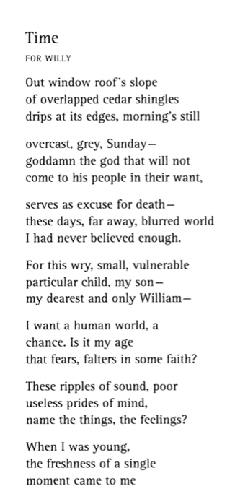
Stephen McLaughlin / @SteveMcLaugh

Slide 10
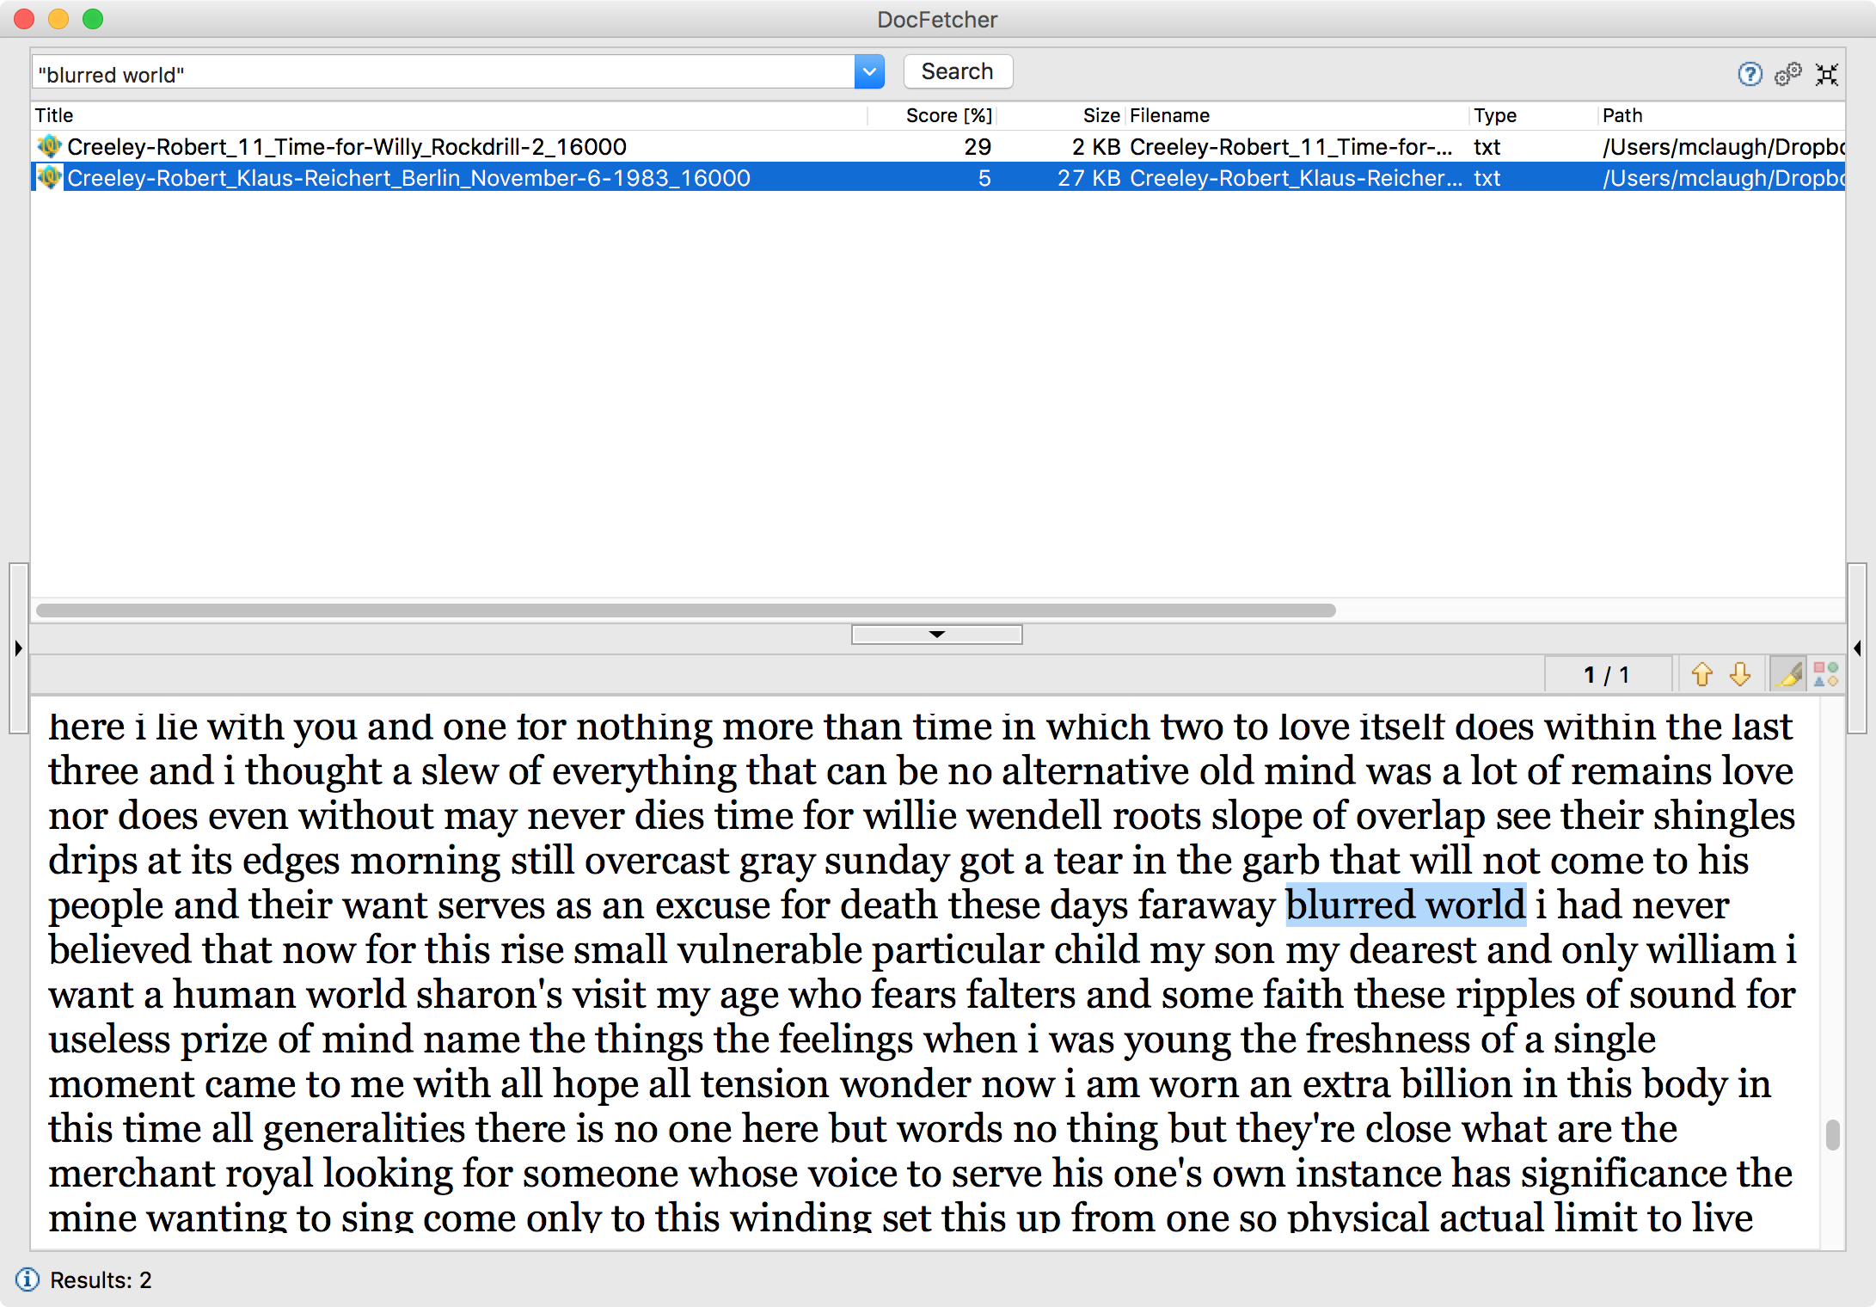
Stephen McLaughlin / @SteveMcLaugh
Notes:
- Jim’s aim: poems that were “competitive,” good enough to read repeatedly.
Source texts: Collected poems of Emily Dickinson or Joseph Conrad’s Heart of Darkness.
At the time I was feeling overwhelmed by the size of the poetry world.
An expression of hopelessness / sneering mockery.

Slide 11
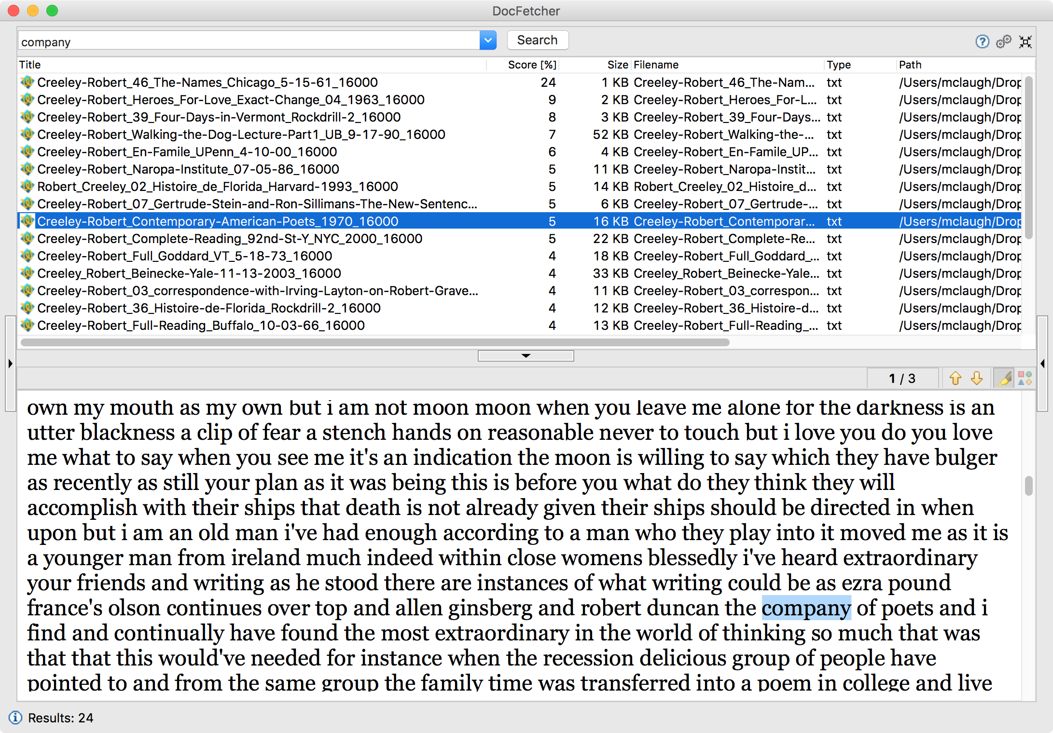
Stephen McLaughlin / @SteveMcLaugh

Slide 12
Stephen McLaughlin / @SteveMcLaugh
Notes:
This is not an option.

Slide 13
Title
1
2
3
4
Stephen McLaughlin / @SteveMcLaugh

Slide 14
Stephen McLaughlin / @SteveMcLaugh
Notes:
This is not an option.

Slide 15
Title
1
2
3
4
Stephen McLaughlin / @SteveMcLaugh

Slide 16
Stephen McLaughlin / @SteveMcLaugh
Notes:
This is not an option.

Slide 17
Title
1
2
3
4
Stephen McLaughlin / @SteveMcLaugh

Slide 18
Stephen McLaughlin / @SteveMcLaugh
Notes:
This is not an option.

Slide 19
Title
1
2
3
4
Stephen McLaughlin / @SteveMcLaugh

Slide 20
Stephen McLaughlin / @SteveMcLaugh
Notes:
This is not an option.

Slide 21
Title
1
2
3
4
Stephen McLaughlin / @SteveMcLaugh

Slide 22
Stephen McLaughlin / @SteveMcLaugh
Notes:
This is not an option.

Slide 23
Title
1
2
3
4
Stephen McLaughlin / @SteveMcLaugh

Slide 24
Stephen McLaughlin / @SteveMcLaugh
Notes:
This is not an option.

Slide 25
Title
1
2
3
4
Stephen McLaughlin / @SteveMcLaugh

Slide 26
Stephen McLaughlin / @SteveMcLaugh
Notes:
This is not an option.

Slide 27
Title
1
2
3
4
Stephen McLaughlin / @SteveMcLaugh

Slide 28
Stephen McLaughlin / @SteveMcLaugh
Notes:
This is not an option.

Slide 29
Title
1
2
3
4
Stephen McLaughlin / @SteveMcLaugh

Slide 30
Stephen McLaughlin / @SteveMcLaugh
Notes:
This is not an option.

Slide 31
Title
1
2
3
4
Stephen McLaughlin / @SteveMcLaugh

Slide 32
Stephen McLaughlin / @SteveMcLaugh
Notes:
This is not an option.

Slide 33
Title
1
2
3
4
Stephen McLaughlin / @SteveMcLaugh

Slide 34
Stephen McLaughlin / @SteveMcLaugh
Notes:
This is not an option.

Slide 35
Title
1
2
3
4
Stephen McLaughlin / @SteveMcLaugh

Slide 36
Stephen McLaughlin / @SteveMcLaugh
Notes:
This is not an option.

Slide 37
Title
1
2
3
4
Stephen McLaughlin / @SteveMcLaugh

Slide 38
Stephen McLaughlin / @SteveMcLaugh
Notes:
This is not an option.

Slide 39
Title
1
2
3
4
Stephen McLaughlin / @SteveMcLaugh

Slide 40
Stephen McLaughlin / @SteveMcLaugh
Notes:
This is not an option.

Slide 41
Title
1
2
3
4
Stephen McLaughlin / @SteveMcLaugh

Slide 42
Stephen McLaughlin / @SteveMcLaugh
Notes:
This is not an option.

Slide 43
Title
1
2
3
4
Stephen McLaughlin / @SteveMcLaugh

